Slide 1

INTERNET OF THINGS SENSORS

Slide 2
Proximity Sensor

Slide 3
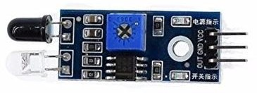
IR Proximity Sensor

Slide 4
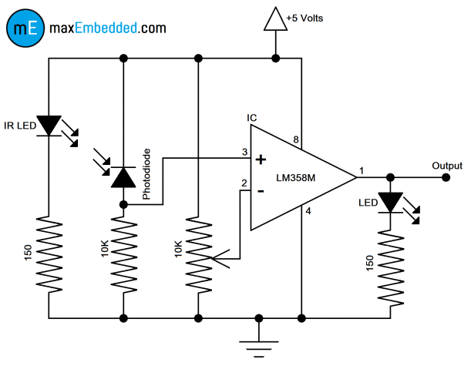
SENSOR CIRCUITARY

Slide 5

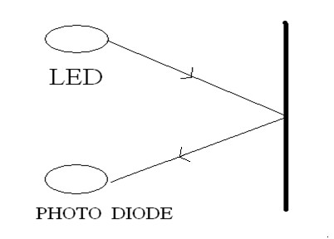

Slide 6
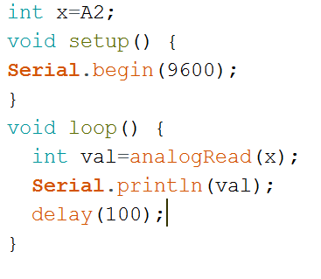
Proximity Sensor Interfacing Code

Slide 7
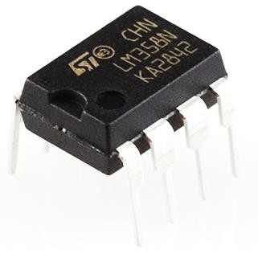
LM358 Comparator
LM358 is a comparator IC Which compares two voltages or currents and switch it at output to indicate which is larger.
It is an Operational - amplifier.

Slide 8
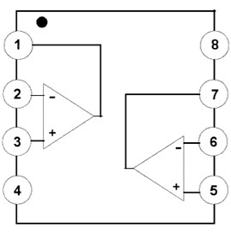
LM358 PIN
Output 1
Vcc
Input 1 ( - )
Output 2
Input 1 ( + )
Input 2 ( - )
GND
Input 2 ( + )

Slide 9
Bread Board
A breadboard also known as proto-board is a type of solder less electronic circuit building platform .You can build a electronic circuit on a breadboard without any soldering.

Slide 10
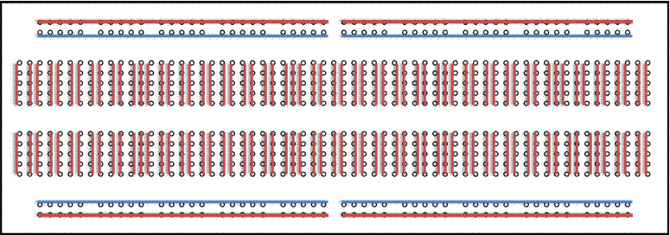
Front View of bread board

Slide 11
HAPPY LEARNING…

Slide 12

THANK YOU

